Slide 1
Central Register of Beneficial Ownership of Trusts (CRBOT)
AMLU Webinar 14th September 2022

Slide 2
Content
Background
The Two Registers
Due Diligence
Discrepancy Notices
Access the Central Register
Information Provided to Designated Persons
Beneficial Owners that are Minors
Further Information

Slide 3
Background
CRBOT was established by S.I. 194/2021 European Union (Anti-Money Laundering: Beneficial Ownership of Trusts) Regulations 2021 in order to implement European Anti- Money Laundering Directives.
Purpose of Register is to provide transparency around beneficial ownership of relevant trusts.
A “relevant trust” is an express trust established by a deed or other declaration in writing. Excluded arrangement can be found in section 106ZC of the Criminal Justice (Money Laundering and Terrorist Financing) Act 2010.
An express trust is one established by deed or other declaration in writing where a settlor has clearly declared that identifiable assets have been placed on trust for the benefit of certain beneficiaries.
Obligation on trustees to file relevant trust details on a Central Register and to keep the registers up to date.
Trust must be filed within 6 months from its coming into existence.

Slide 4
The Two Registers
Trustees are required to submit and update information on two separate registers.
Regulation 7 outlines the information they should hold on their own beneficial owners register.
Regulation 23 outlines the information a trustee must provide to the central register.
This information should be the same.

Slide 5
Due Diligence
Regulation 7(7) places an obligation on the trustee when entering a business relationship or occasional transaction with a designated person to provide information on the beneficial ownership of the trust. The designated person may also request this information from the trustee.
Section 35 (3) (a) of the Criminal Justice (Money Laundering and Terrorist Financing) 2010 places an obligation on designated person when entering a business relationship with a relevant trust to ascertain that information concerning the beneficial ownership of the customer is entered in the relevant trust’s beneficial ownership register or in the Central Register of Beneficial Ownership of trusts, as the case may be.
As part of this process a discrepancy between the two registrations may be found.
Notes:
Trusts feature in a wide variety of customers from non- profits to large financial transactions. Trusts may be used during bond and debt issuances, yet they may also be used by local sports clubs and charities. So it is good to always be aware that your customer’s structure may include a trust

Slide 6
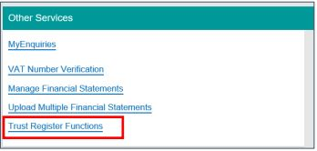
Access to the Register
Regulation 27(2) gives designated persons the access a trusts information for due diligence checks.
Request access number & trust registration number from trustee.
Access number valid for 14 days.
Access the trust through Trust Register Functions on ROS.
Notes:
Some examples of times when a designated person should check the register for customer information are when they are opening a bank account, entering a contract or engaging a solicitor or accountant.

Slide 7
Discrepancy Notice
Regulation 22 places an obligation on designated person to deliver, in a timely manner, a discrepancy notice to the registrar where they form the opinion that there is a discrepancy between the information contained in a trust beneficial ownership register and the central register of beneficial ownership of trusts. The Registrar will consider and apply the notice in line with regulations.
Regulation 30 (6) states a designated person who fails the delivery of discrepancy notice) commits an offence and shall be liable, on summary conviction, to a class A fine.
Only material factual differences should be reported.
Form available on website: ‘CRBOT discrepancy form’. Submit via MyEnquiries.

Slide 8
Information Provided to Designated Persons
Name.
Beneficial Owner Type.
Month & Year of Birth.
Country of Residence.
Nationality.
Nature & Extent of Interest Held.
Information relating to a minor is not disclosed.

Slide 9
Beneficial Owners that are Minors
Information relating to a minor who is a beneficial owner must be requested in writing.
Form available on website: ‘CRBOT minor information access request’. Submit via MyEnquiries on ROS.
You must contend why it is in the ‘public interest’ that minor information must be disclosed.
Registrar will consider application and respond.

Slide 10
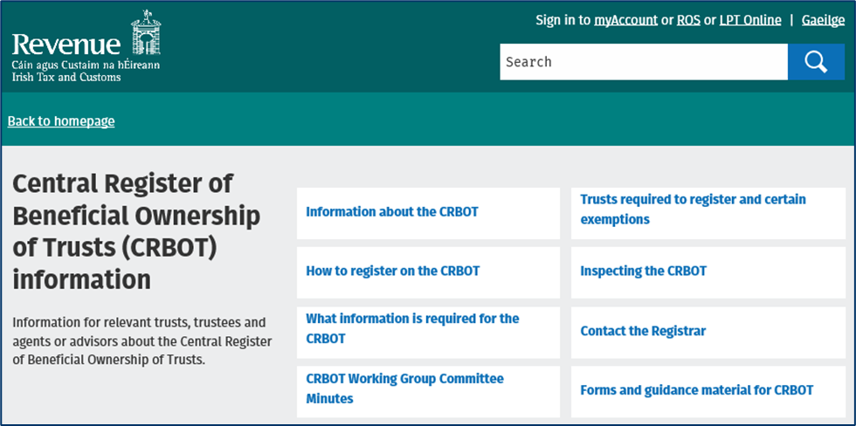
Further information
https://www.revenue.ie/en/crbot

